Slide 1
FIRE SAFETY IN THE PERIOPERATIVE SETTING

Slide 2

LEARNING OBJECTIVES
Increased knowledge of appropriate actions to take to extinguish an OR fire.
Knowledge how to protect patients and personnel during a fire.
How to use a fire extinguisher.
Knowledge of hospital policy regarding a fire.

Slide 3

LOCATION OF FIRES
AMBULATORY SURGERY CENTERS
HOSPITALS
PHYSICIAN OFFICES
Notes:
Fires can occur in any location where the three sides of the fire triangle—a fuel, an oxidizer, and an ignition source—come together, including in ambulatory surgery centers, large or small hospitals, and even in physicians’ offices where surgical procedures are performed.

Slide 4

FIRE FACTS
Estimated Frequency:
200 to 240 per year in the United States
      44% head, neck, or upper chest
      26% elsewhere on the patient
      21% in the airway
Notes:
There is no clear data regarding how many fires really occur in the OR. The estimates on this slide are based on the collective evidence. The estimate of 200 to 240 fires per year in the OR is down from the previous estimate of 550 to 650 per year. The anatomical locations where fires occur include 44% on the head, neck, or upper chest and 26% elsewhere on the patient. Examples of fires on the patient include a fire on the drapes or the patient’s skin. It is also estimated that 21% of OR fires occur in the patient’s airway and 8% occur elsewhere in the body (eg, within a body cavity).

Slide 5

IGNITION SOURCES
OXIDIZERS
Laser beam
Electrosurgical unit
Argon
Power tools
Light cord
Electrical Equipment
Defibrillator
Oxygen
Oxygen-enriched environment
Nitrous oxide
FUELS
Patient
Personnel
Drapes, Dressings, Tapes
Gowns, Linens, Head coverings, hair
Sponges
Alcohol-based skin prep
Endotracheal tubes
Notes:
Ignition source- anything that provides energy to start a fire.
Oxidizer-Gases that support combustion
Fuel-anything that will burn

Slide 6
INTERVENTIONS TO PREVENT FIRE
Be sure to place the patient return electrodes on a large muscle.
Inspect electrical cord and keep them from coiling.
Be sure to secure the ESU in the appropriate holster.
Secure laser fiber and place wet towels around surrounding tissue.
Keep the light source in Standby until use.
Tent drapes to allow free air flow.
Keep the oxygen percentage as low as patient can tolerate during head and neck cases.
Use an incise drape if possible.
Be sure to use wet/moist sponges around the surgical site, especially, if in the throat.

Slide 7
INTERVENTIONS
Ensure there are no anesthesia circuit leaks.
Turn off the oxygen at the end of every procedure.
Use water-based ointment and not oil-based ointment in facial hair or near the surgical site.
Prevent pooling of skin prep solutions.
Always remove prep-soaked linens.
ALWAYS!!! Allow skin-prep agents to dry and fumes to dissipate prior to draping.
Conduct a skin prep “time out”
Notes:
CMS / MEDICARE- dictate actions required for skin-preps.

Slide 8
WHO IS RESPONSIBLE FOR PREVENTION
TEAM EFFORT!!!
Nurses
Surgical techs
Surgeons
Assistants
Environmental Services
Administration team members

Slide 9
FIRE PREVENTION ASSESSMENT
Prior to the start of all procedures.
Total participation from ALL TEAM members.
Communicate during the “Time Out”.
Identify Ignition sources that are present.
Identify Fuels that are present.
Identify the potential for the presence of oxygen-enriched environment.
Document the assessment.
Notes:
The OR fire prevention assessment should be done before the procedure begins. This will enable the team to be better prepared for an emergency should it occur. Fire prevention is a team effort and the information needs to be communicated to all members of the team. For this reason, all team members must be present to participate in the fire risk assessment. A good time to communicate the fire risk assessment is during the time-out procedure. (Note to presenter: Make this specific to your facility)
The fire risk assessment should also be documented in the patient’s record. Documentation of the fire risk assessment will assist other facility personnel with quality or risk management projects, and, if a fire occurs, documentation can provide information and support the actions that were taken during the fire.
The fire prevention assessment is completed to determine which of the three components of the fire triangle are present and, from this, to determine which interventions should be performed to prevent a fire.

Slide 10
FIGHTING FIRES ON OR IN A PATIENT
Alert the team that there is a fire.
Assist the Anesthesia staff to turn off/stop the flow of gases.
Remove burning materials away from the patient.
Have another team member extinguish the fire.
  Extinguish the fire with water or saline.
  Use a fire extinguisher as the last response.
  Extinguish the fire (burning materials) on the floor.
  Be sure to care for the patient.
  Save all the involved materials.
Assess the surgical field for a secondary fire on the underlying drapes or towels.
Assess for injury.
Report the injury to the physician.
Document your assessment.
Activate the Fire system if necessary.
Notify the proper chain of command.

Slide 11
ENDOTRACHEAL TUBE FIRE
Call for help.
Assist Anesthesia.
  Immediately remove the tube and any segments of the burned tube.
  Disconnect the tube from oxygen source.
  Pour water or saline into the airway.
  Turn off the flow of gases.
  Care for the patient:
    Reestablish the airway.
    Ventilate with air until you are sure there is no more debris smoldering or burning.
    Examine the airway.
Notes:
When fighting a fire involving an endotracheal (ET) tube, the first step remains the same and that is to alert the team there is a fire. The anesthesia professional simultaneously and immediately disconnects the tubing from the anesthesia machine and removes the ET tube and the breathing circuit. Saline or water should be poured into the airway to cool any burned tissue in the pharynx. The flow of oxygen at the anesthesia machine should also be turned off.
After the fire is extinguished, the anesthesia professional should re-establish the airway and ventilate the patient with air until certain there is no material still burning or smoldering, and then switch to 100% oxygen and examine the airway. The rest of the team should assist the anesthesia professional as necessary.

Slide 12
EQUIPMENT FIRES
Call for help.
Disconnect the equipment from the electrical source.
Shut off the equipment if unable to disconnect.
Turn off gases to equipment if applicable.
Assess the size of the fire to determine if equipment can be removed safely or if evacuation is necessary.
Extinguish the fire with a extinguisher, if appropriate.
Activate the fire system.
Notify appropriate chain of command.
Notes:
The first step is again to alert the team that there is a fire. The next step is to disconnect the equipment from the source of electricity if this can be done safely. Extinguish the fire by the best method, activate alarms, and notify the chain of command. As in other fire situations, various people will be accomplishing these steps simultaneously. The current at the electrical supply (the fuse box or electrical panel) will only need to be shut off if you are unable to remove the plug from the outlet. When the electricity is disconnected at the panel, other monitors and equipment may also lose electrical power.
The assessment of the size of the fire needs to be made rapidly because the room may fill with smoke. This may lead to the smoke detectors being activated, resulting in the air circulation system shutting down. If you are using an extinguisher on the fire, try to stand between the patient and the fire so the majority of the extinguishing agent will be discharged away from the patient, which may help to decrease contamination of the patient.

Slide 13
WHAT IF THERE IS A FIRE SOMEWHERE OTHER THAN THE OR AREA
Stay in your assigned area until you are designated to go somewhere else.
Stay calm.
Do not start a case in your room (elective procedure).
Wait for further instructions which may be to prepare for evacuation.
Notes:
In addition to or instead of extinguishing a fire using a solution, the fire may be smothered. Grab a towel. Drop the end or side of the towel between the fire and the patient’s airway, keeping the towel between you and the fire. Lean into the patient and place your arm at the dropped end of the towel. Drop the other end of the towel over the fire. Sweep with your free hand over the towel to extinguish the fire. Do not pat the fire because this will fan the flames, and it will continue to grow.
When the fire is extinguished, raise the towel to decrease the heat. For your safety, keep your body, especially your face, as far away from the fire as possible.

Slide 14
FIRE EXTINGUISHER STEPS:
P Pull the pin.
A Aim the nozzle at the base of the fire.
S Squeeze the handle.
S Sweep the stream over the base of the fire.
EVACUATION STEPS:
R Rescue
A Alarm/Alert
C Confine/Contain
E Evacuate
Notes:
If it is necessary to use a fire extinguisher, the first step is to obtain it from its storage location. (Note to presenter: Insert the location at your facility). When you are picking up the extinguisher, be aware that it may be heavy. Many extinguishers weigh about 20 pounds.
The extinguisher will have a handle that is locked by a pin. Take the handle of the extinguisher in one hand and pull the pin with the free hand. Do not compress the handle because this will result in the agent being dispersed from the nozzle. Drop the pin and, using your free hand, grab the hose and aim the end of the nozzle at the base of the fire. Do not continue to grab the nozzle because it may become very cold. Stand approximately 8 to 10 feet from the base of the fire. Squeeze the handle to release the agent and sweep back and forth to “chase the fire away.”
As the fire diminishes, move forward until the fire is extinguished or the extinguisher is empty. If the fire is not extinguished, evacuate the premises. Remember, fire extinguishers should not be your first line of defense. They are effective for extinguishing small fires.

Slide 15
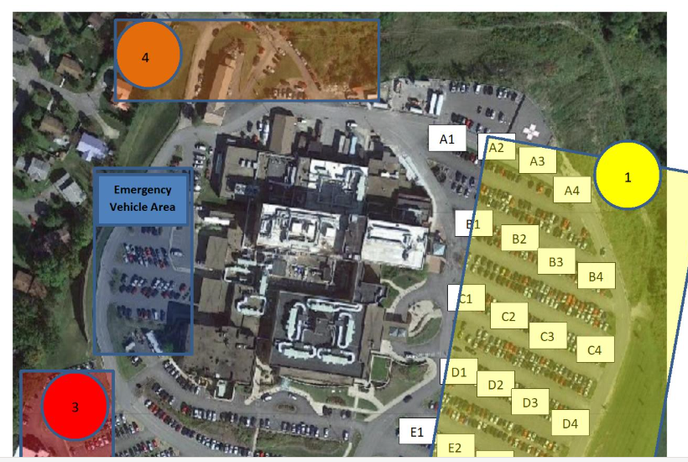
EVACUATION PLAN
Who determines evacuation?
OR-SURGICARE
MOA PARKING LOT
RED ZONE #3
Incident command
  Lateral transfer
  Horizontal transfer
  Evacuation

Slide 16
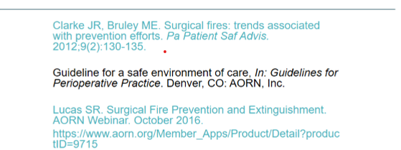
REFERENCES:

